Slide 1

DPW-VII Opening Remarks
John Vassberg
Chairman, DPW-OC
Aviation 2022
Chicago, IL
June 25-26, 2022

Slide 2
DPW-VII: “Expanding The Envelope”
Introduction
Organizing Committee
Agenda
DPW History
Test Cases 1-6
Participant Demographics
CRM WB Geometry
Measured Wing Deflections
CRM Reference Quantities
Gridding Guidelines & Family Plan
Baseline Grid Families
Vassberg Multi-Block & Overset
NLR Multi-Block
JAXA Unstructured
DLR Unstructured

Slide 3
DPW-VII: “Expanding The Envelope”
Introduction
Organizing Committee
Agenda
DPW History
Test Cases 1-6
Participant Demographics
CRM WB Geometry
Measured Wing Deflections
CRM Reference Quantities
Gridding Guidelines & Family Plan
Baseline Grid Families
Vassberg Multi-Block & Overset
NLR Multi-Block
JAXA Unstructured
DLR Unstructured

Slide 4
DPW-VII: Organizing Committee
Olaf Brodersen, DLR
Ed Feltrop, Cessna
David Hue, ONERA
Stefan Keye, DLR
Kelly Laflin, Cessna
Dimitri Mavriplis, UWy
Joe Morrison, NASA
Mitsuhiro Murayama, JAXA
Raj Nanjia, RAeS
Ben Rider, Boeing
Melissa Rivers, NASA
Ed Tinoco, Retired
Chris Toomer, UWE Bristol
John Vassberg, JetZero
Rich Wahls, NASA
15 Members
2 Charter Members
3 New Members
10 Institutions
5 Countries
3 Continents

Slide 5
DPW-VII Agenda – Day 1

Slide 6
DPW-VII Agenda – Day 2

Slide 7
DPW Series – Brief History
DPW Charter Formalized Jan 2000
State of the Art/Practice CFD Drag Prediction
DPW-I, Anaheim, CA Jun 2001
DLR-F4 WB, Fixed CL & Drag Polar Studies
Scatter > 100 Counts → SOP Worse Than Expected
DPW-II, Orlando, FL Jun 2003
DLR-F6 WB & WBNP, Fixed-CL Grid Convergence
Scatter > 50 Counts, Drag Deltas, Juncture Flow Issues
DPW-III, San Francisco, CA Jun 2006
DLR-F6 WB & WBF, DPW-W1/W2 Wing-Only Fixed AoA
DPW-IV, San Antonio, TX Jun 2009
CRM WBT, Trim-Drag Study, Blind CFD Predictions
DPW-V, New Orleans, LA Jun 2012
CRM WB, Common Grid Study, TMR Verification Case
DPW-VI, Washington, DC Jun 2016
CRM WB & WBNP, Aero-Elastic Deflection Study
DPW-VII, Chicago, IL Jun 2022
CRM WB, “Expanding the Envelope Beyond RANS”

Slide 9
DPW-VII: “Expanding The Envelope”
Introduction
Organizing Committee
Agenda
DPW History
Test Cases 1-6
Participant Demographics
CRM WB Geometry
Measured Wing Deflections
CRM Reference Quantities
Gridding Guidelines & Family Plan
Baseline Grid Families
Vassberg Multi-Block & Overset
NLR Multi-Block
JAXA Unstructured
DLR Unstructured

Slide 10
DPW-VII: Case 1 “Halfway to Buffet”
Case 1: CRM Wing-Body Grid Convergence Study
Use 3.00-deg LoQ AE CRM Geometry/Grids
Use at least 4 Grids in Family
Plot [ CD, CM, AoA ] .vs. N^{-(2/3)}
Case 1a (Requested)
M = 0.85, Re = 20 million, Fixed CL = 0.58, T = -250°F
Case 1b (Optional)
M = 0.85, Re = 05 million, Fixed CL = 0.58, T = 100°F

Slide 11
DPW-VII: Case 2 “Polar with AE Effects”
Case 2: CRM Wing-Body Static LoQ Aero-Elastic Effect
AoA Sweep with ETW Deflections
CL = 0.50 on 2.50-deg LoQ Geometry
AoA = [2.50, 2.75, 3.00, 3.25, 3.50, 3.75, 4.00, 4.25] degrees
Medium Baseline Grids: [ 9 Solutions on 8 Grids/Geometries ]
Case 2a (Requsted)
Mach=0.85, Re=20 million, T=-250ºF
Case 2b (Optional)
Mach=0.85, Re=05 million, T=100ºF

Slide 12
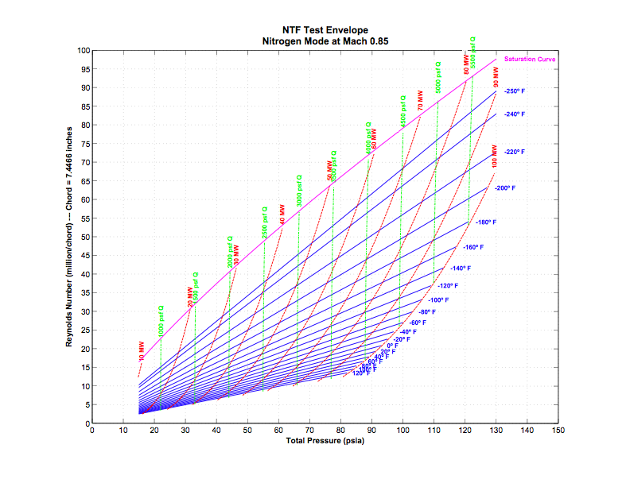
DPW-VII: Case 3 “Ren & AE Effects”
Case 3: CRM WB Ren-Sweep at Fixed CL
M = 0.85, CL = 0.50, Medium Grids
Re=05M, LoQ 2.50-deg R05 Grid, T= 100°F
Re=20M, LoQ 2.50-deg R30 Grid, T= -250°F
Re=20M, HiQ 2.50-deg R30 Grid, T = -182°F
Re=30M, HiQ 2.50-deg R30 Grid, T = -250°F
Increasing model load

Slide 13
DPW-VII: Case 4 “Grid Adaptation”
Case 4: CRM WB Grid Adaptation – Alpha Sweep
Optional Test Case
M = 0.85, Re = 20 million, T = -250°F
CL = 0.50 on 2.50-deg LoQ Geometry
AoA = [2.50, 2.75, 3.00, 3.25, 3.50, 3.75, 4.00, 4.25] degrees
Start Adaptation from Appropriate Baseline LoQ Mesh or AE Geometry
Participants to Document Adaptation Process
Additional cases: M = 0.85; Re = 5 million; T = 100°F

Slide 14
DPW-VII: Case 5 “Beyond RANS”
Case 5: Beyond RANS
Optional Test Case
URANS, DDES, WMLES, Lattice Boltzmann, etc.
M = 0.85, Re = 20 million, T = -250°F
CL ~ 0.58 on 3.00-deg LoQ Geometry
AoA = [2.50, 2.75, 3.00, 3.25, 3.50, 3.75, 4.00, 4.25] degrees
Use Appropriate LoQ AE Geometry

Slide 15
DPW-VII: Case 6 “Couple AE Simulation”
Case 6: CRM WB Coupled Aero-Elastic Simulation
Optional Test Case
M = 0.85, Re = 20 million, T = -250°F
CL = 0.58
AoA = [2.50, 2.75, 3.00, 3.25, 3.50, 3.75, 4.00, 4.25] degrees
Start AE Process with NoQ AE Geometry or NoQ R30 Medium Grid

Slide 16
DPW-VII: Participant Demographics
18 Teams/Organizations
7 N. America, 7 Europe, 4 Asia
7 Government, 3 Industry, 3 Academia, 5 Commercial
30 Total Data Submittals
Grid Types:
16 Unstructured
3 Overset
3 Structured Multi-Block
1 Custom Cartesian
Turbulence Models:
14 SA (w/ & w/o QCR), 4 SST, 2 EARSM, 1 SSG/LRR, 1 AMM-QCR, 1 RSW-ln(w)

Slide 17
DPW-VII: “Expanding The Envelope”
Introduction
Organizing Committee
Agenda
DPW History
Test Cases 1-6
Participant Demographics
CRM WB Geometry
Measured Wing Deflections
CRM Reference Quantities
Gridding Guidelines & Family Plan
Baseline Grid Families
Vassberg Multi-Block & Overset
NLR Multi-Block
JAXA Unstructured
DLR Unstructured

Slide 18
Common Research Model (CRM)
CRM WB Configuration
Undeflected Wing
Vassberg AIAA 2008-6919

Slide 19
Common Research Model (CRM)
CRM WB Configuration
Undeflected Wing
Vassberg AIAA 2008-6919

Slide 20
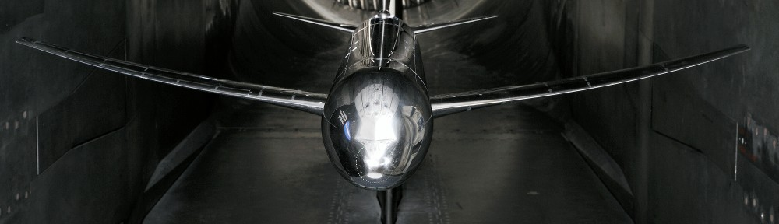
Common Research Model (CRM)
http://commonresearchmodel.larc.nasa.gov/

Slide 21
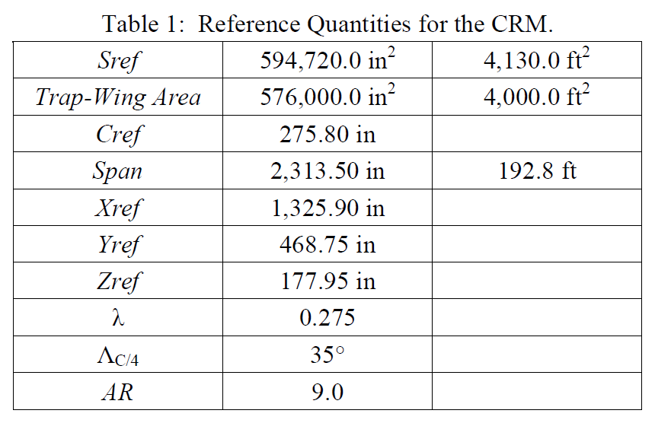
Common Research Model (CRM)

Slide 22
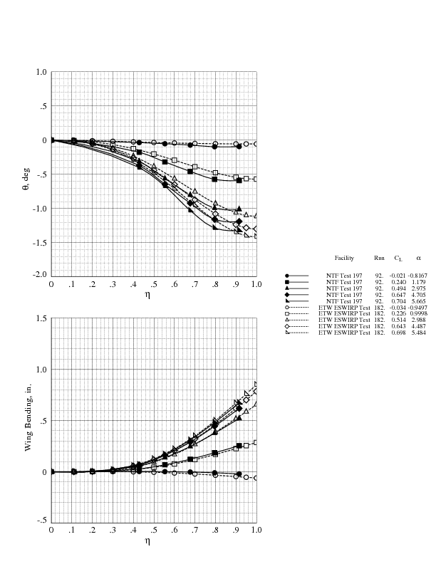
CRM Wing Deflections in NTF, ETW
DPW-7 Utilizes ETW Deflections

Slide 23
DPW-VII: “Expanding The Envelope”
Introduction
Organizing Committee
Agenda
DPW History
Test Cases 1-6
Participant Demographics
CRM WB Geometry
Measured Wing Deflections
CRM Reference Quantities
Gridding Guidelines & Family Plan
Baseline Grid Families
Vassberg Multi-Block & Overset
NLR Multi-Block
JAXA Unstructured
DLR Unstructured

Slide 24
DPW-VII: Gridding Guidelines (1/2)
Tiny Grid (L1)
Viscous Wall Spacing: Y⁺ ~ 1.0 → ∆y₁ = 0.0002332”
Based on local C_{f} @ 10% Cref for Re_{c} = 30 million
C_{f} ~ 0.455 / ln²(0.06*Re_{x}) = 0.003107, where Re_{x} = 0.1*Re_{c} = 3 million
∆y₁ = Cref / [Re_{c}*sqrt(C_{f}/2)] = 0.0002332”
At Least 2 Constantly-Spaced Cells at Viscous Walls, ∆y₂ = ∆y₁
Growth Rates < 1.2X Normal to Viscous Walls
Wing Spanwise Spacing < 0.1%*Semispan at Root & Tip
Wing Chordwise Spacing < 0.1%*C (Local Chord) at LE & TE
Wing TE Base >> 8 Cells
Spacing Near Fuselage Nose & End-of-Body < 1%*Cref
Grow Next-Finer Grid in Family by ~ [(L+2)/(L+1)]³ in Size
Scale Dimensions in All Three Directions by ~ [(L+2)/(L+1)]
Grid Spacings Should Reduce as follows, (0.1% in Tiny Grid)
[T,C,M,F,X,U] = [0.100, 0.067, 0.050, 0.040, 0.033, 0.029]%

Slide 25
DPW-VII: Gridding Guidelines (2/2)
Farfield Boundary > 100*Semispans
Miscellaneous Notes:
Try to be Multigrid Friendly on Structured Meshes
Store Grid Coordinates in 64-bit Precision
If Storing Grids in Plot3D Format, Keep Zones < 38M Nodes
Itemize Surface Elements by Components [W, B, Sym, Far]
Itemize Element Count for Unstructured Meshes
Volume: Tetrahedra, Prisms, Pyramids, Hexahedra
Surface: Triangles, Quads
Total of 15 Grids Needed per Grid Type
Subtotal of 8 AE Medium Grids @ Low-Q for Alpha Sweep
Subtotal of 1 AE Medium Grid @ High-Q for Q Effect
Subtotal of 1 Medium Grid on Undeflected Geometry for Case 6
Subtotal of 6 Grids in Grid Family for Grid Convergence
AE3.00degLoQ Geometry, CL = 0.58, Re = 20M, (Re = 5M Optional)

Slide 26
DPW-VII: Baseline RANS Grid Family Plan
Name | L | WB | ∆y₁ | Y⁺ | #∆y₁s
Tiny (T) | 1 | ~5 | 0.0002332” | ~1.00 | 2
Coarse (C) | 2 | ~17 | 0.0001555” | ~0.67 | 3
Medium (M) | 3 | ~40 | 0.0001166” | ~0.50 | 4
Fine (F) | 4 | ~78 | 0.0000933” | ~0.40 | 5
Extra Fine (X) | 5 | ~135 | 0.0000777” | ~0.33 | 6
Ultra Fine (U) | 6 | ~215 | 0.0000666” | ~0.29 | 7
Rough Nominal Size of Grid System in M-DOF
At Least 4 Sequential Mesh Levels & Bias Towards Finest

Slide 27
DPW-VII: “Expanding The Envelope”
Introduction
Organizing Committee
Agenda
DPW History
Test Cases 1-6
Participant Demographics
CRM WB Geometry
Measured Wing Deflections
CRM Reference Quantities
Gridding Guidelines & Family Plan
Baseline Grid Families
Vassberg Multi-Block & Overset
NLR Multi-Block
JAXA Unstructured
DLR Unstructured

Slide 28
DPW-VII: Vassberg Grid Family Data
Name | L | WB | ∆y₁ | Y⁺ | #∆y₁s
Tiny (T) | 1 | 5,286,597 | 0.0002332” | ~1.00 | 2
Coarse (C) | 2 | 17,644,325 | 0.0001555” | ~0.67 | 3
Medium (M) | 3 | 41,590,149 | 0.0001166” | ~0.50 | 4
Fine (F) | 4 | 80,957,925 | 0.0000933” | ~0.40 | 5
Extra Fine (X) | 5 | 139,581,509 | 0.0000777” | ~0.33 | 6
Ultra Fine (U) | 6 | 221,294,757 | 0.0000666” | ~0.29 | 7

Slide 29
DPW-VII: Vassberg Grid Topology

Slide 30
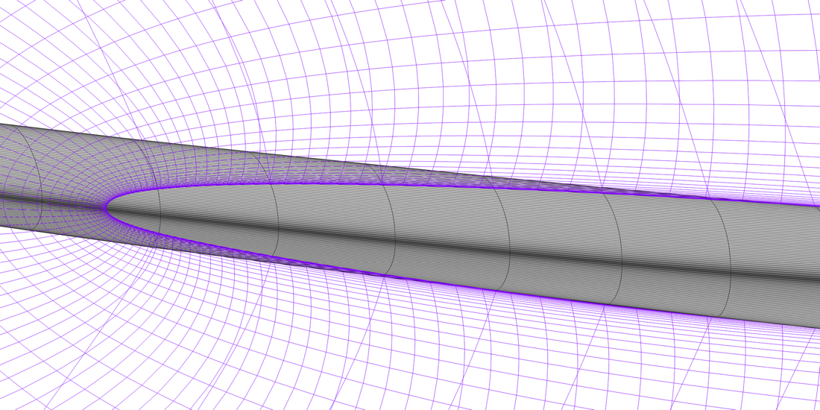
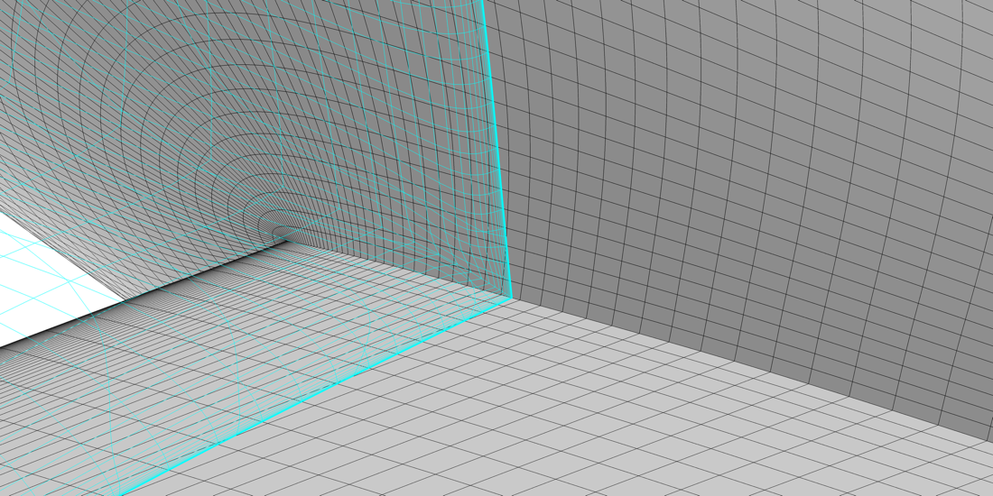
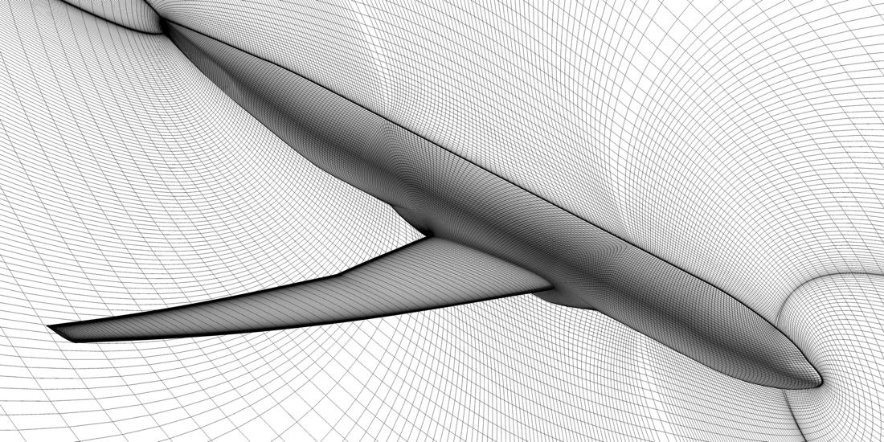
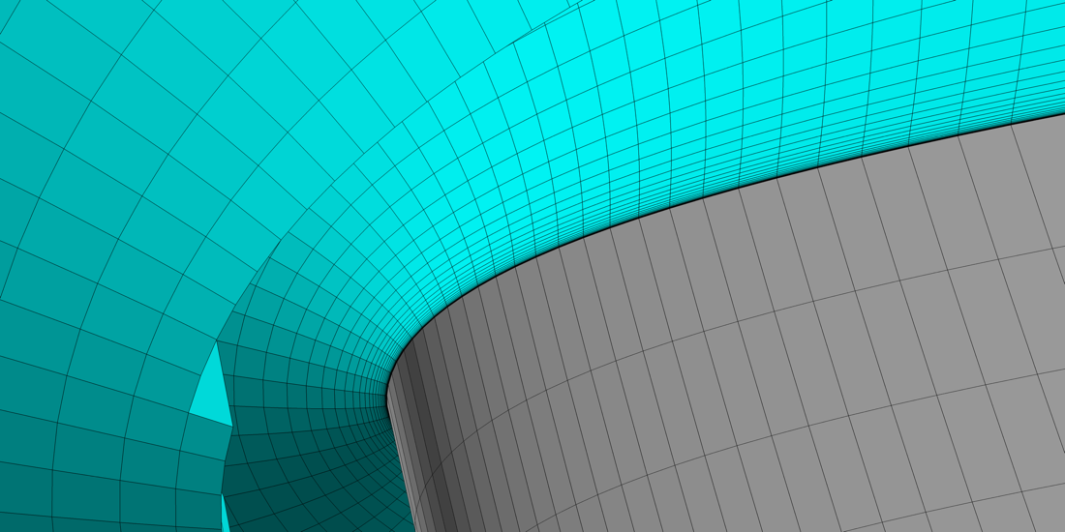
DPW-VII: Vassberg Grid Topology

Slide 31
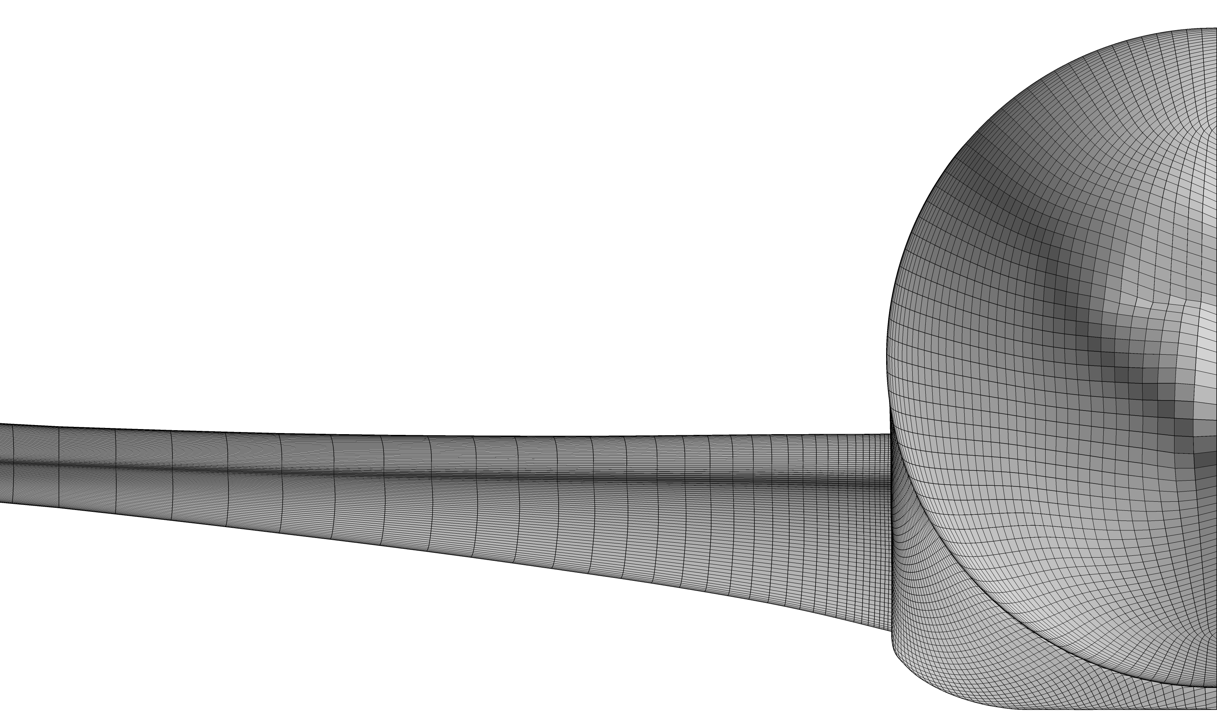
DPW-VII: Vassberg L1 Tiny Grid

Slide 32

DPW-VII: Vassberg L2 Coarse Grid

Slide 33
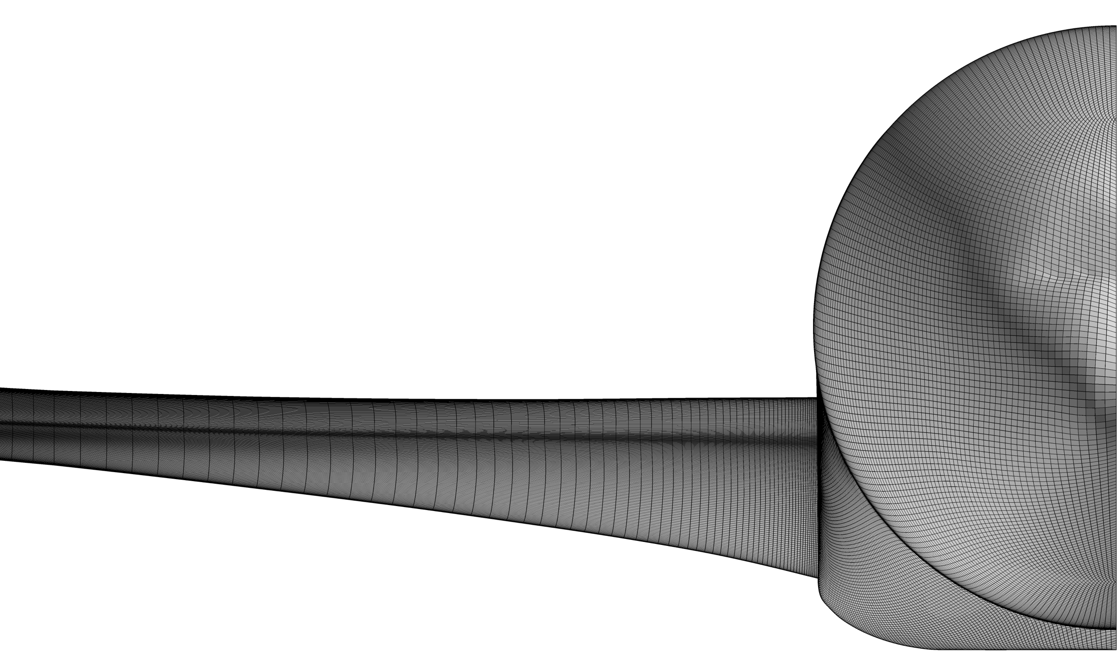
DPW-VII: Vassberg L3 Medium Grid

Slide 34

DPW-VII: Vassberg L4 Fine Grid

Slide 35
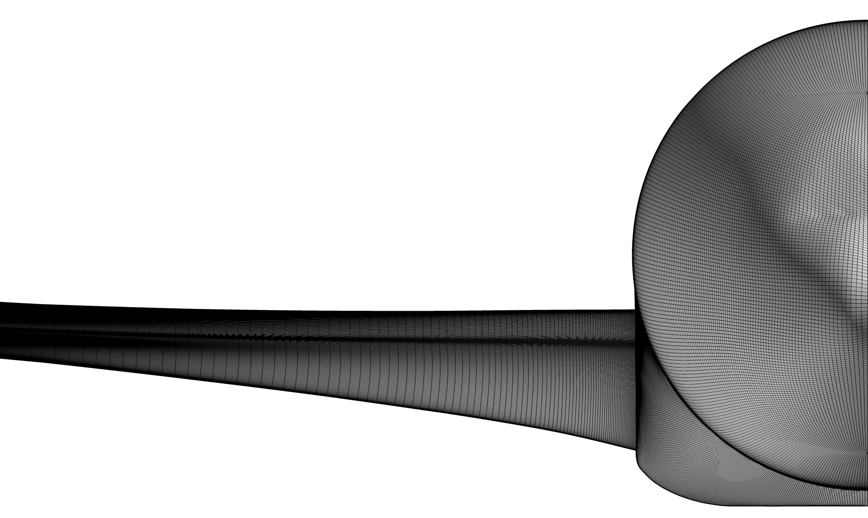
DPW-VII: Vassberg L5 Extra-Fine Grid

Slide 36
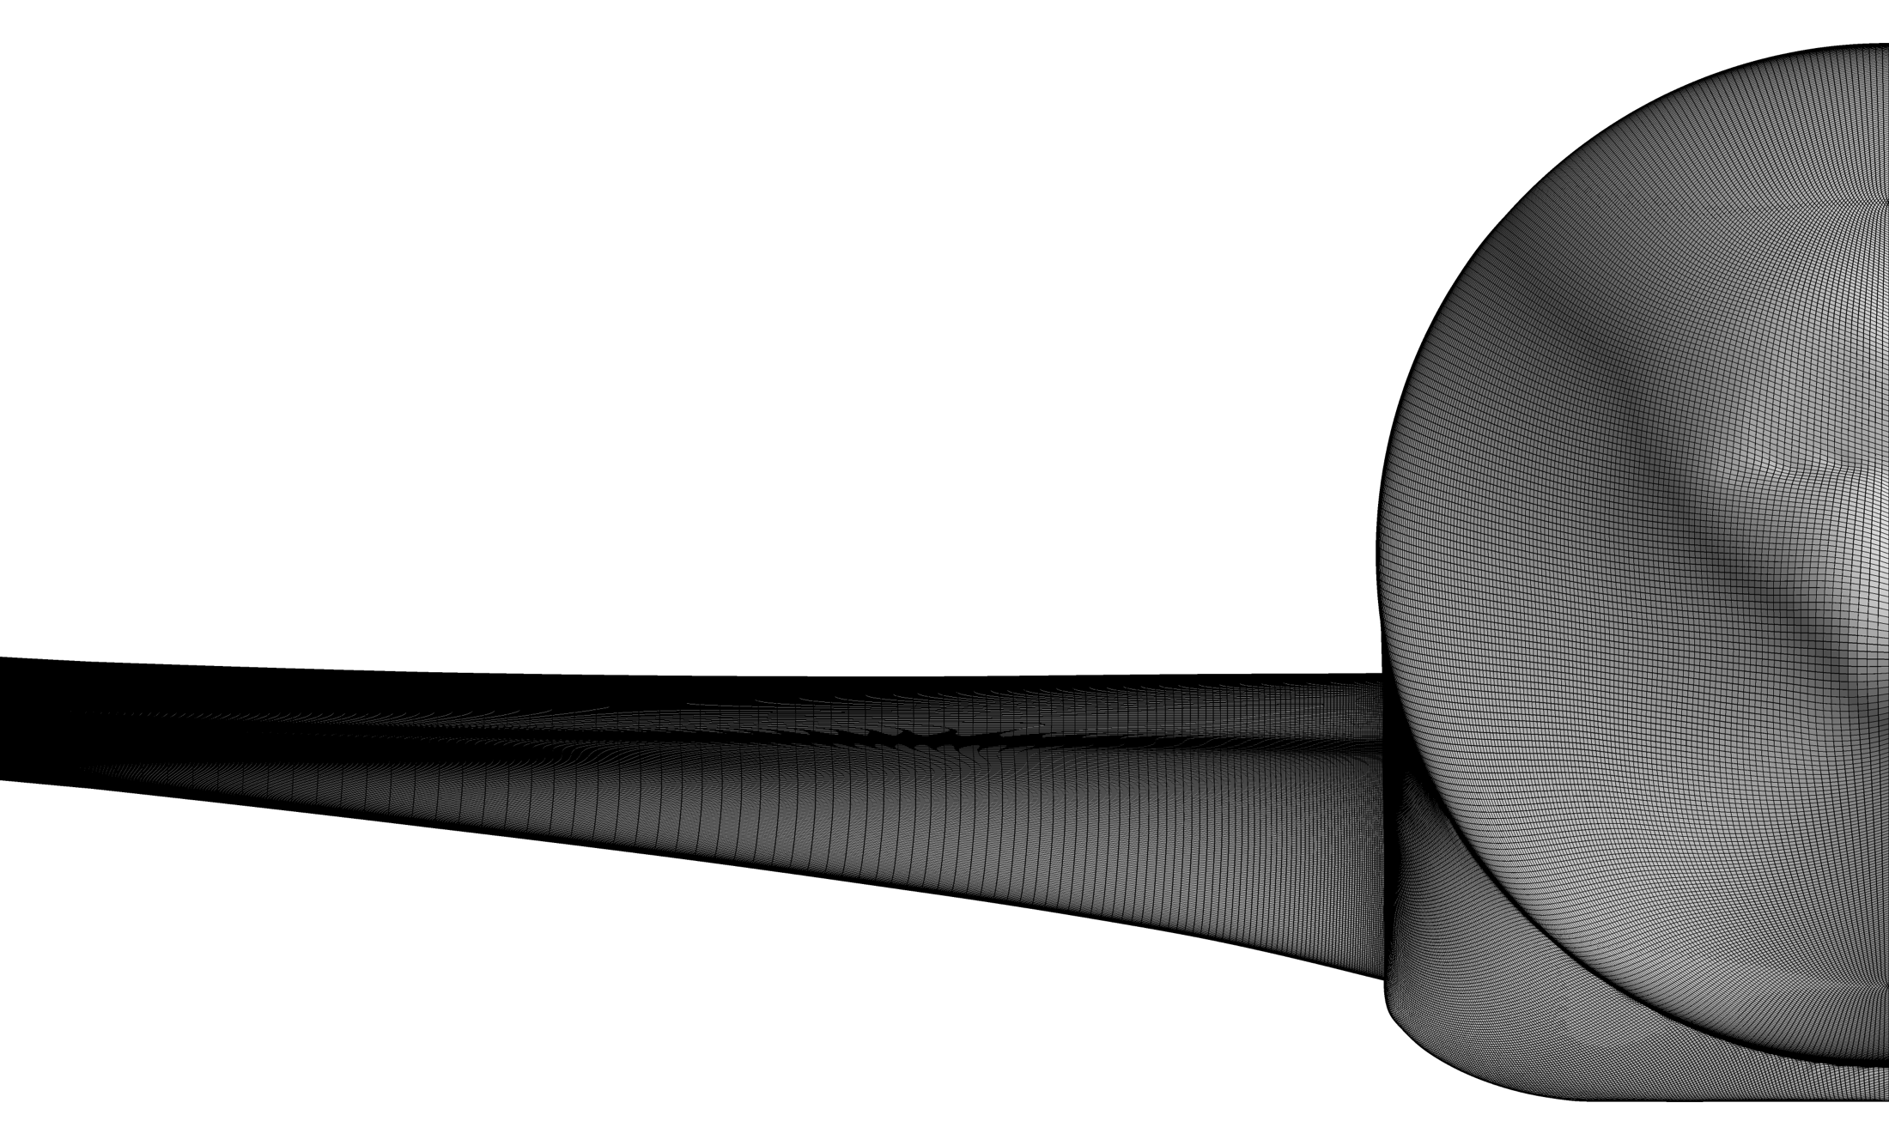
DPW-VII: Vassberg L6 Ultra-Fine Grid

Slide 37
DPW-VII: “Expanding The Envelope”
Introduction
Organizing Committee
Agenda
DPW History
Test Cases 1-6
Participant Demographics
CRM WB Geometry
Measured Wing Deflections
CRM Reference Quantities
Gridding Guidelines & Family Plan
Baseline Grid Families
Vassberg Multi-Block & Overset
NLR Multi-Block
JAXA Unstructured
DLR Unstructured

Slide 38
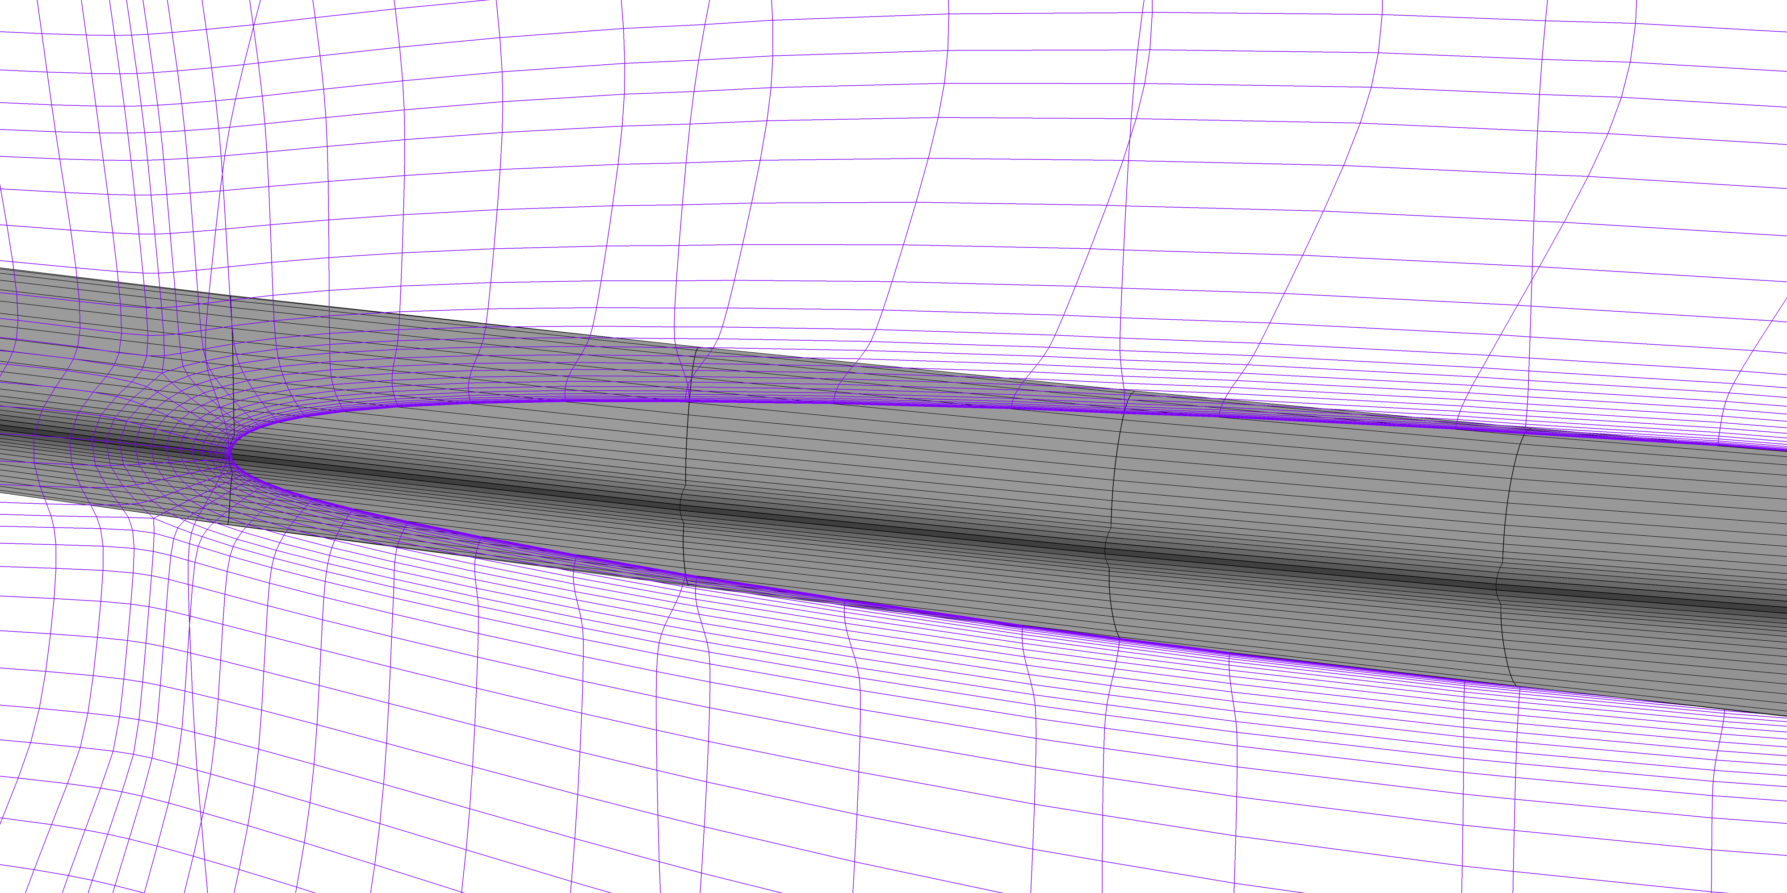
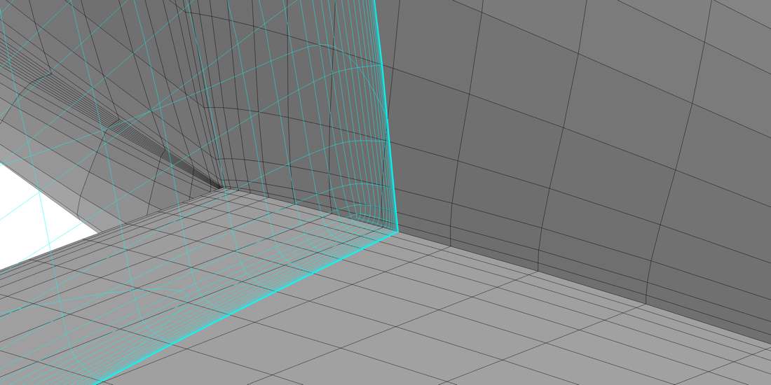
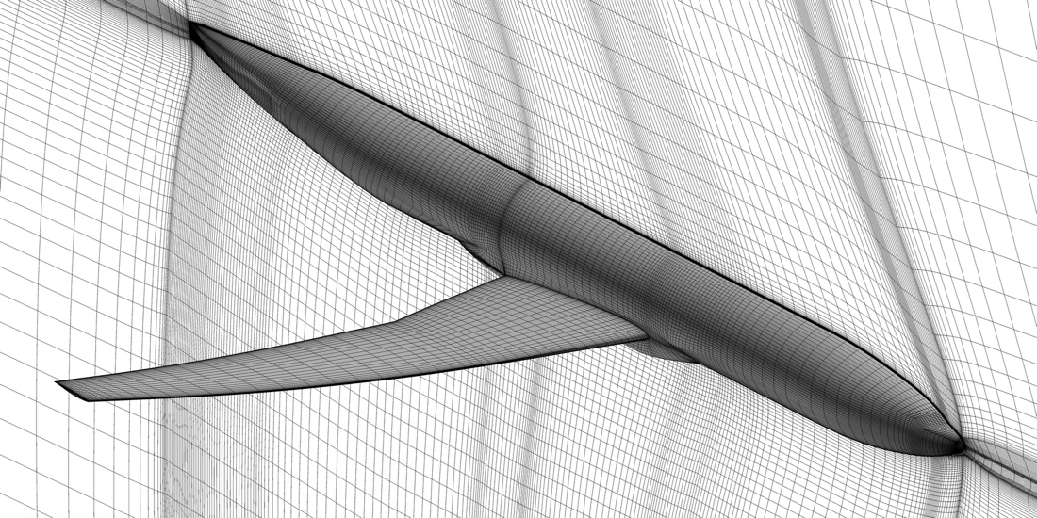
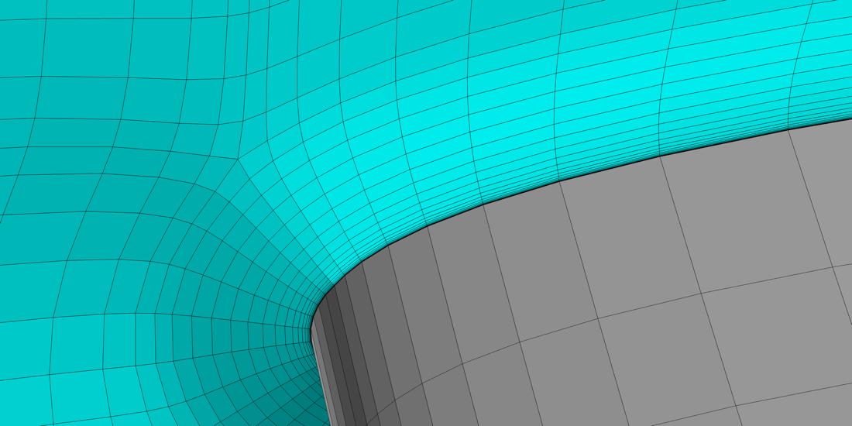
DPW-VII: NLR Grid Topology

Slide 39
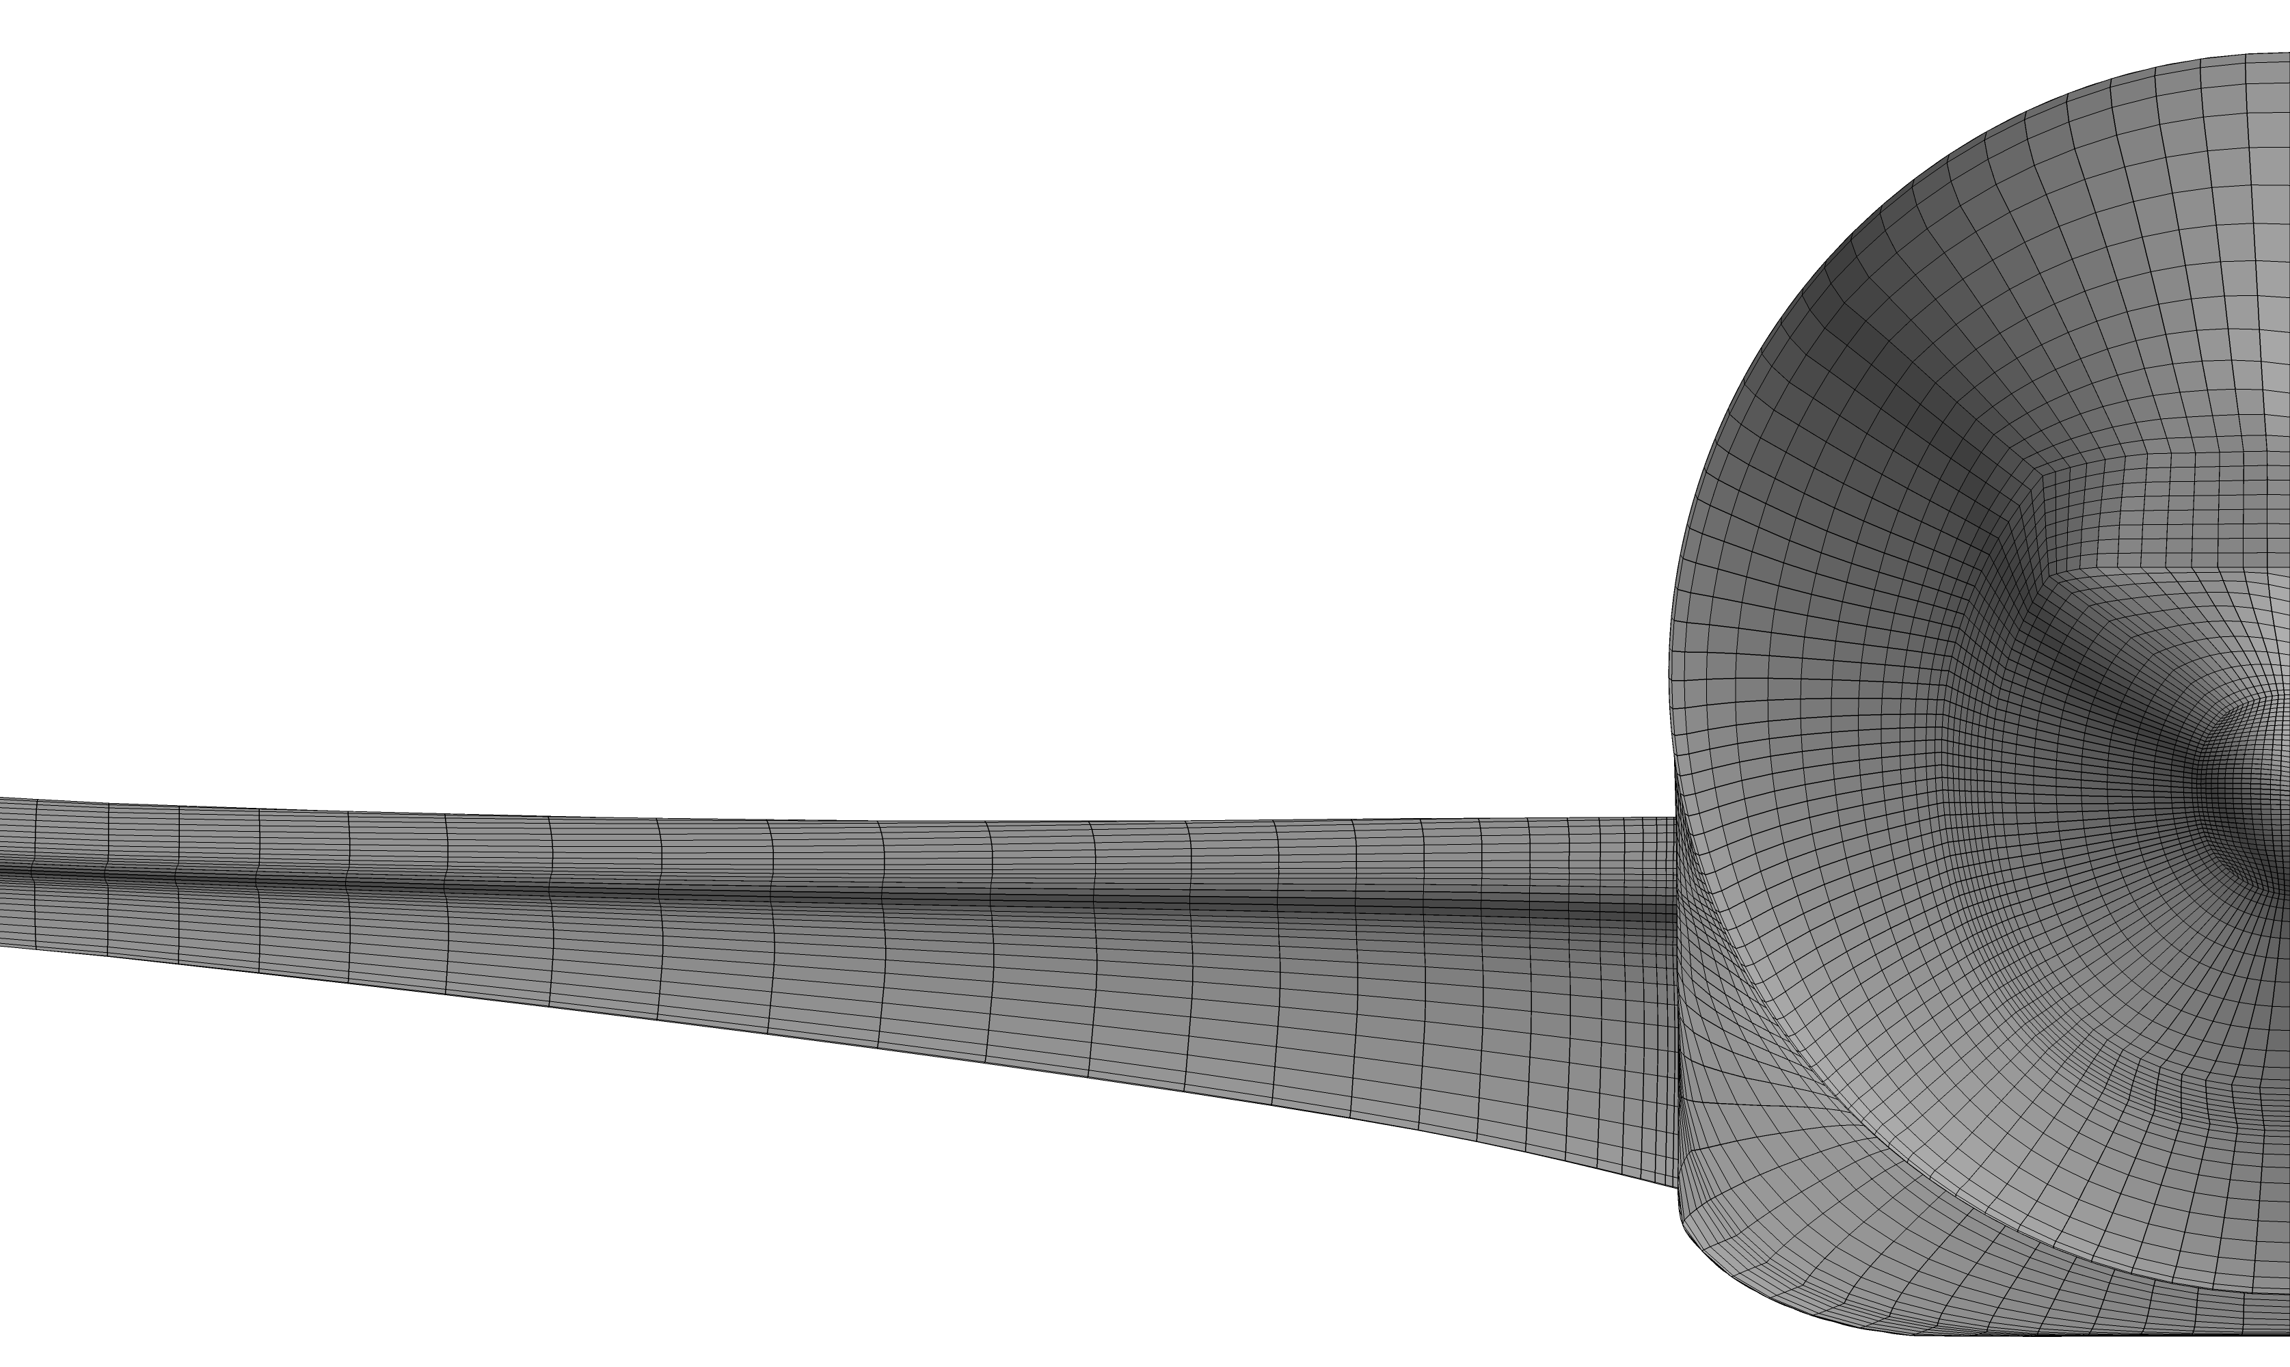
DPW-VII: NLR L1 Tiny Grid

Slide 40

DPW-VII: NLR L2 Coarse Grid

Slide 41
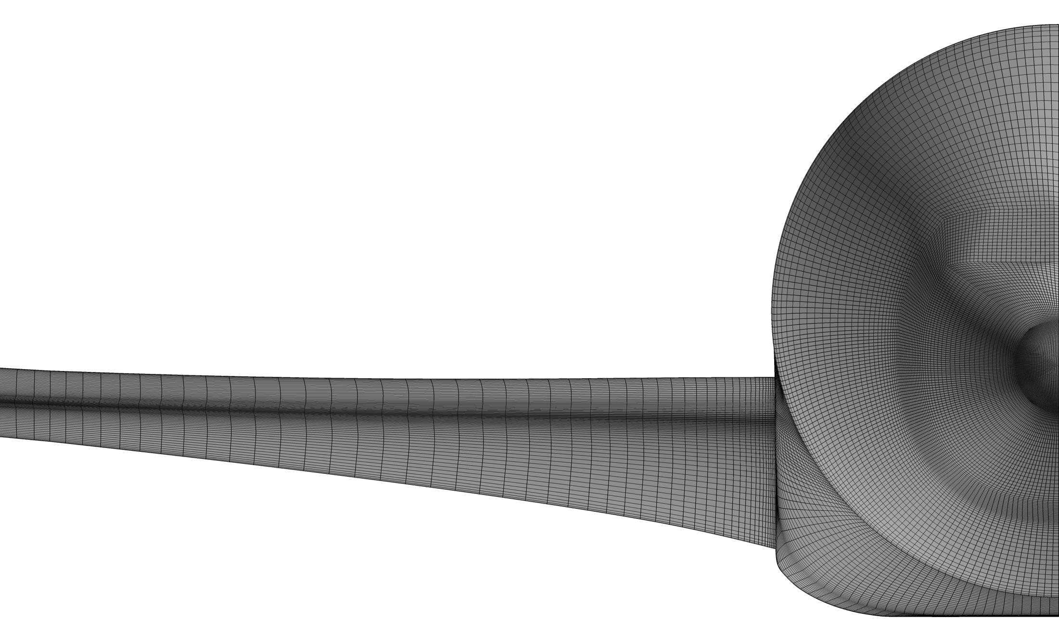
DPW-VII: NLR L3 Medium Grid

Slide 42

DPW-VII: NLR L4 Fine Grid

Slide 43
DPW-VII: “Expanding The Envelope”
Introduction
Organizing Committee
Agenda
DPW History
Test Cases 1-6
Participant Demographics
CRM WB Geometry
Measured Wing Deflections
CRM Reference Quantities
Gridding Guidelines & Family Plan
Baseline Grid Families
Vassberg Multi-Block & Overset
NLR Multi-Block
JAXA Unstructured
DLR Unstructured

Slide 44
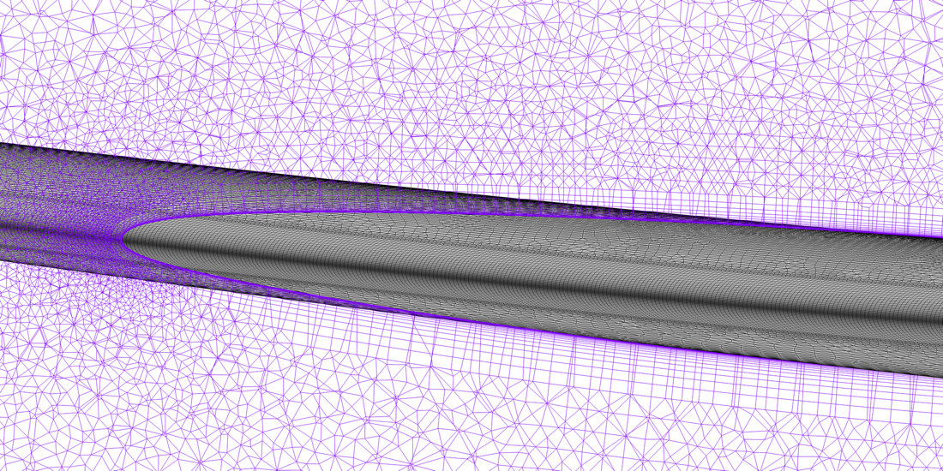
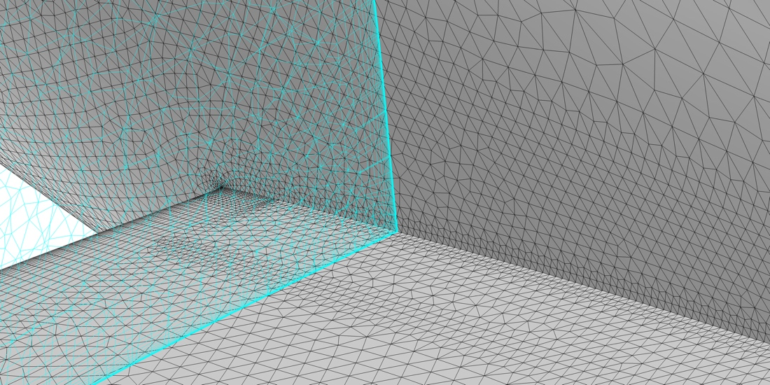
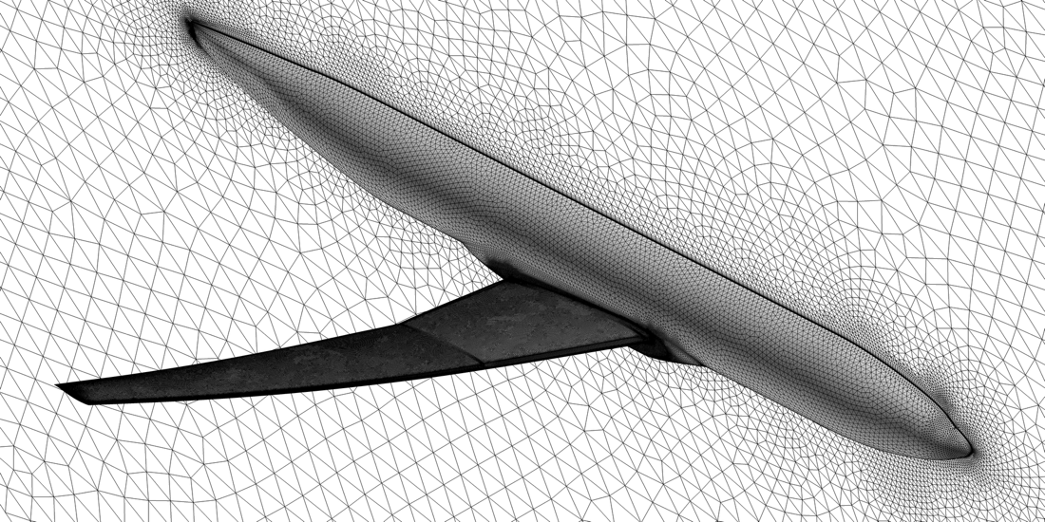
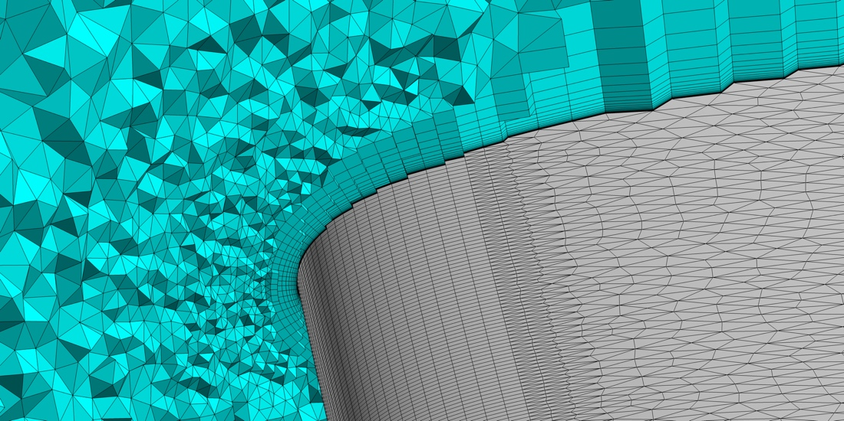
DPW-VII: JAXA Grid Topology

Slide 45
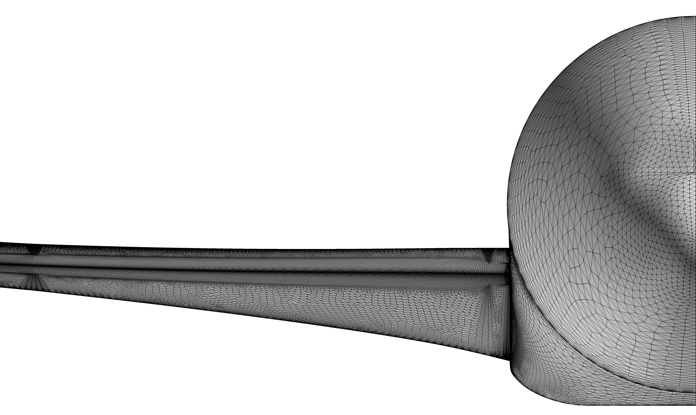
DPW-VII: JAXA L1 Tiny Grid

Slide 46
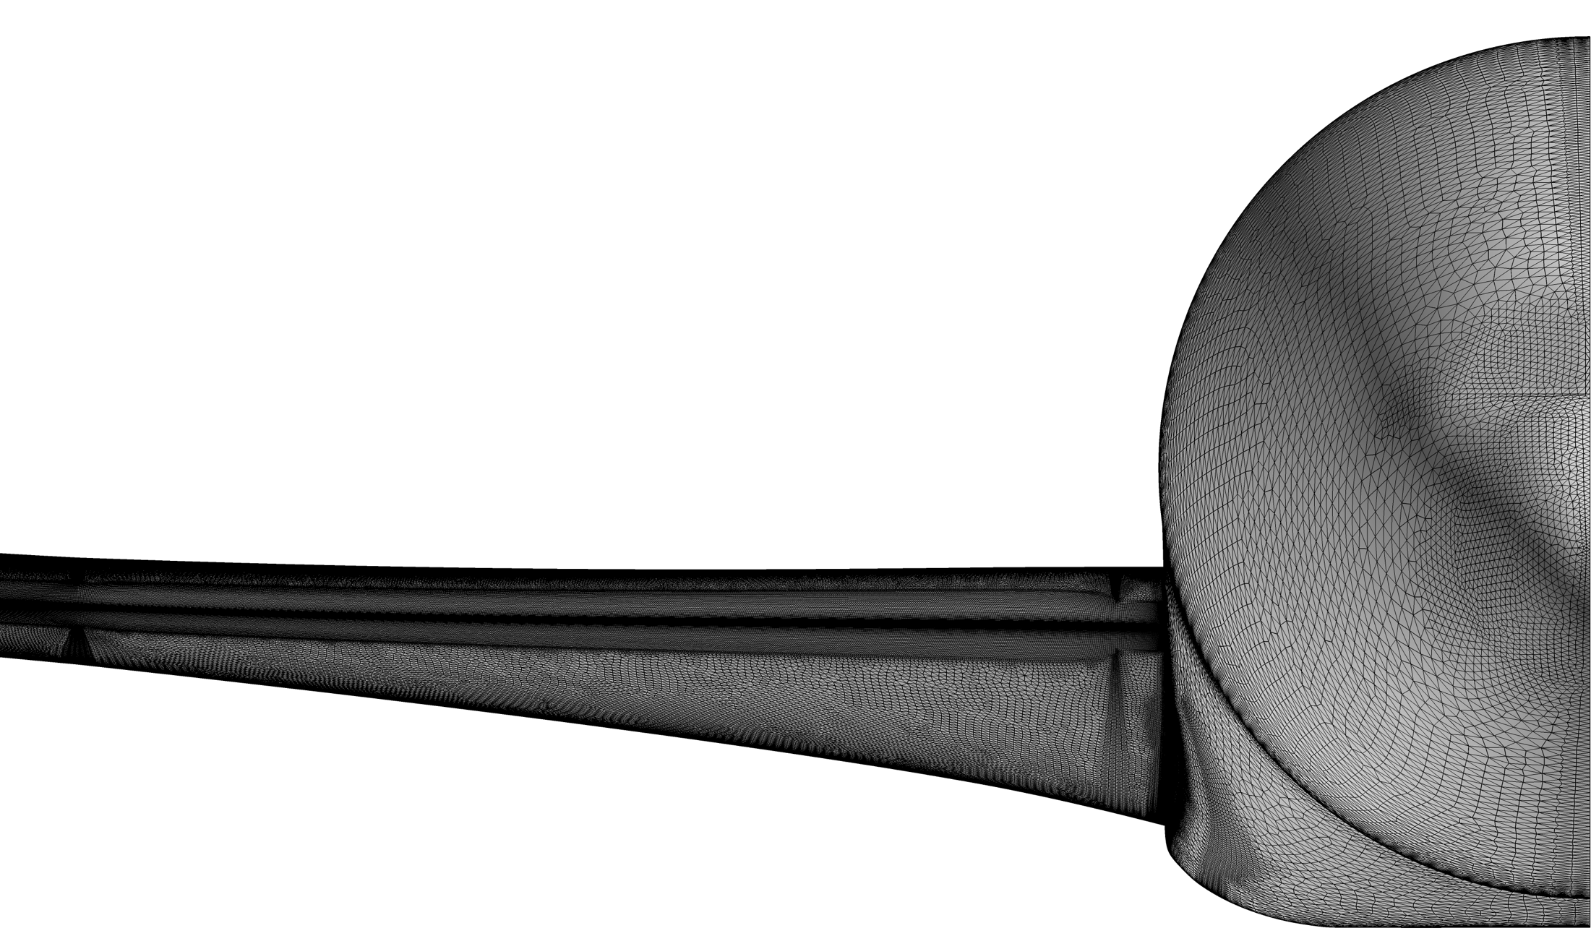
DPW-VII: JAXA L3 Medium Grid

Slide 47
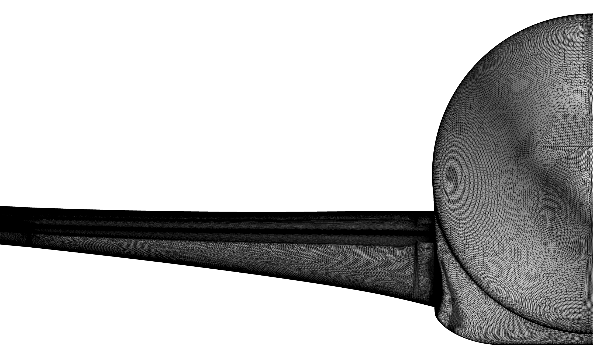
DPW-VII: JAXA L5 Extra-Fine Grid

Slide 48
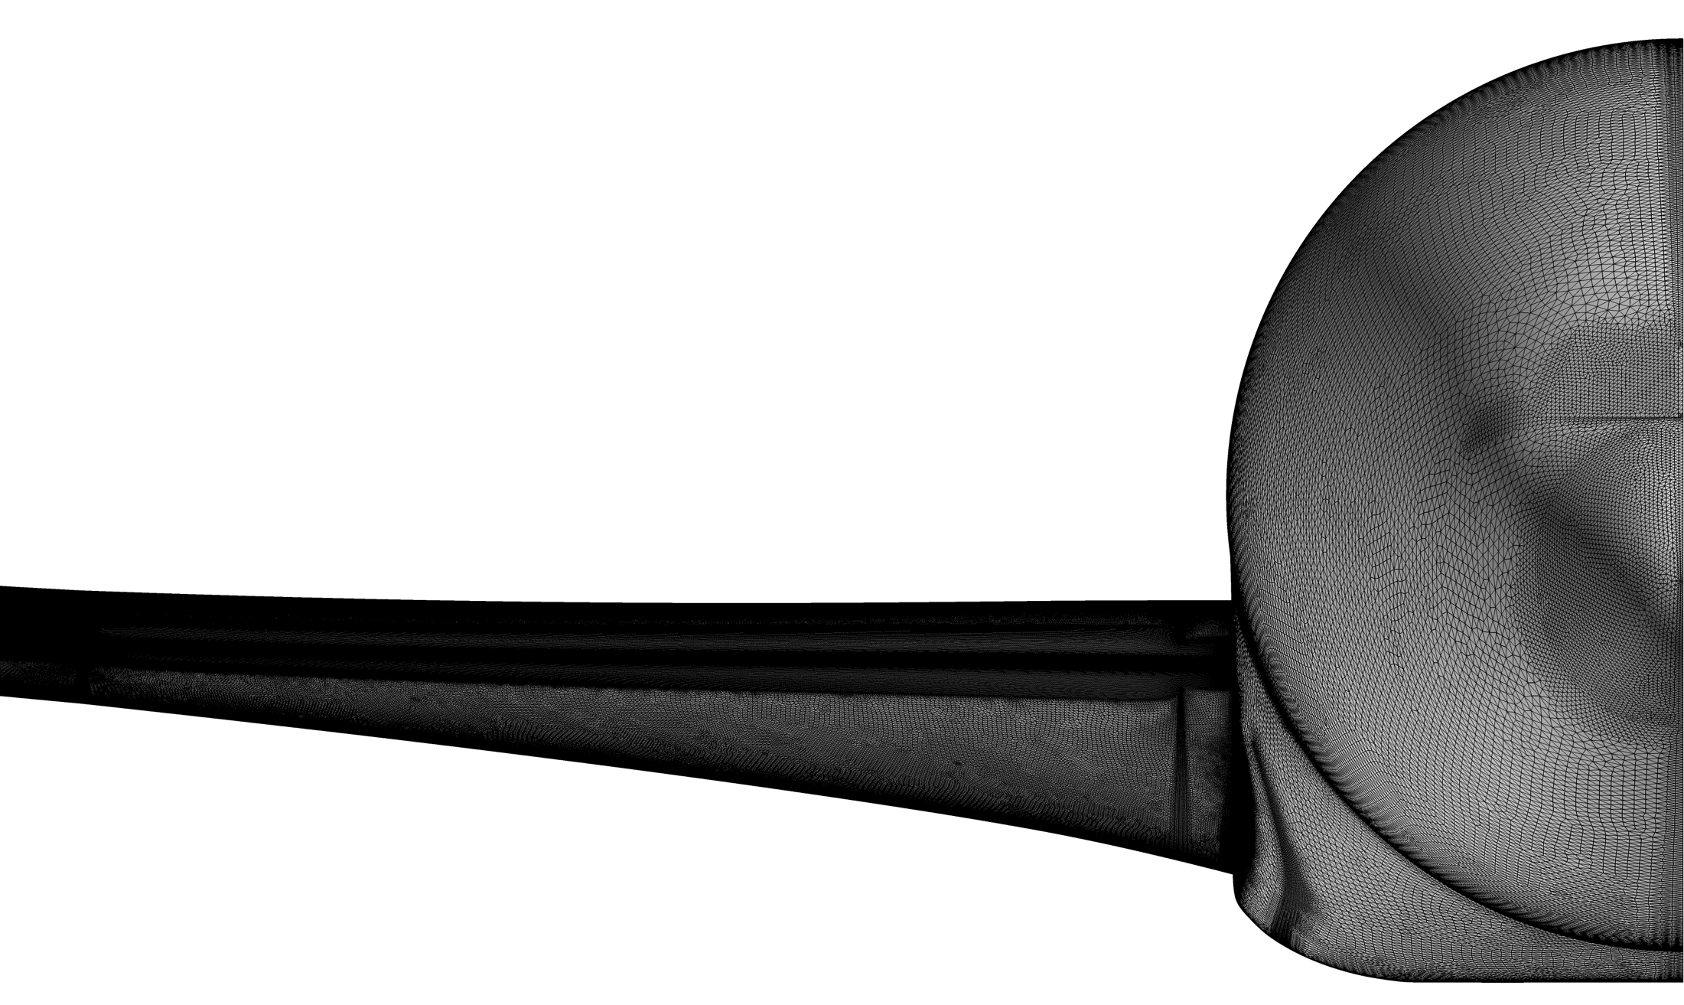
DPW-VII: JAXA L6 Ultra-Fine Grid

Slide 49
DPW-VII: “Expanding The Envelope”
Introduction
Organizing Committee
Agenda
DPW History
Test Cases 1-6
Participant Demographics
CRM WB Geometry
Measured Wing Deflections
CRM Reference Quantities
Gridding Guidelines & Family Plan
Baseline Grid Families
Vassberg Multi-Block & Overset
NLR Multi-Block
JAXA Unstructured
DLR Unstructured

Slide 50
DPW-VII: DLR Grid Family Statistics
Grid | Points /[10⁶] | Elements /[10⁶] | Surface Points /[10⁶] | y₁/[μm] | # Layers | # constant Cells @ Wall | Stretching Ratio in BL
T | 11.70 | 31.59 | 0.506 | 6.560 | 53 | 2 | 1.2
C | 25.01 | 64.33 | 0.837 | 4.374 | 53 | 3 | 1.2
M | 47.06 | 130.7 | 1.317 | 3.280 | 52 | 4 | 1.2
F | 76.51 | 224.1 | 1.931 | 2.624 | 52 | 5 | 1.2
X | 118.8 | 367.9 | 2.726 | 2.187 | 52 | 6 | 1.2
U | 164.5 | 534.2 | 3.485 | 1.874 | 53 | 7 | 1.2
Additional Grid Family built using Hybrid Meshing Approach:
SOLAR for Surface Mesh
ANSA (BETA CAE Systems, USA) for Boundary Layer / Farfield Mesh
Grids available on DPW-7 Website

Slide 51
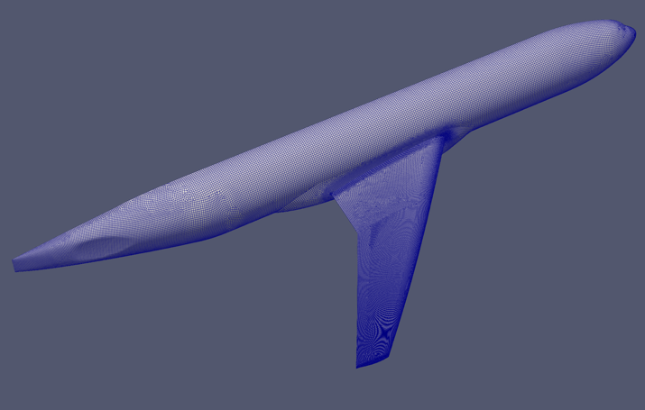
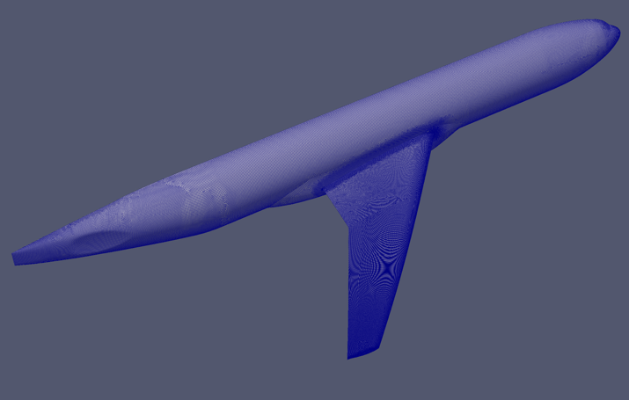
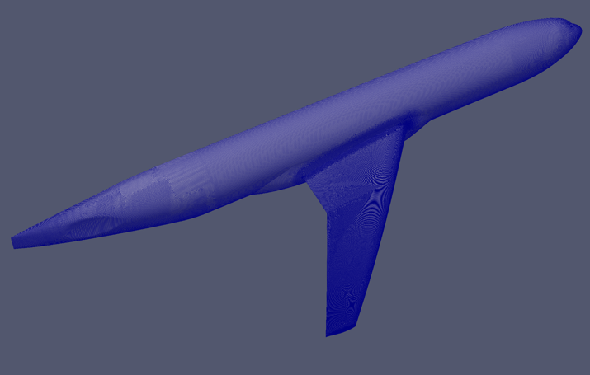
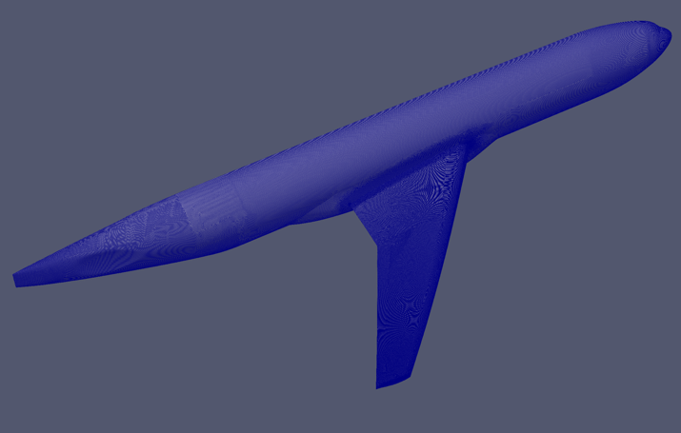
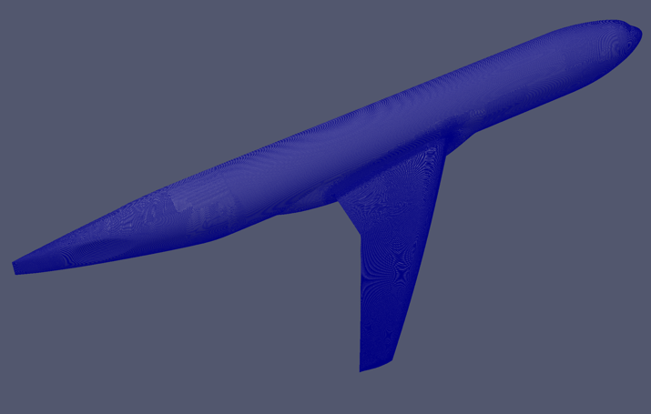
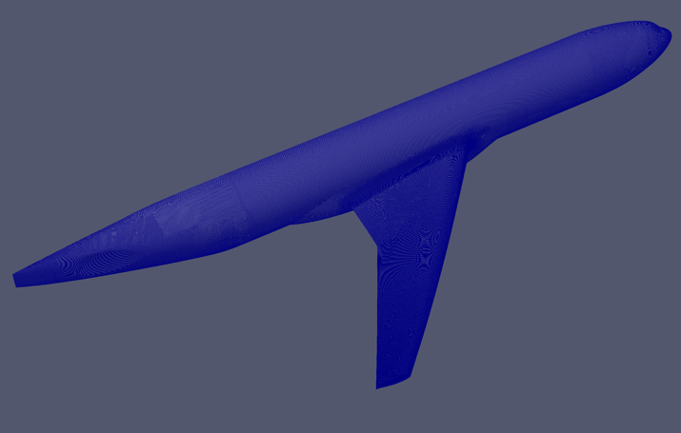
Tiny
Coarse
Medium
0.51x10⁶ Points
0.84x10⁶ Points
1.3x10⁶ Points
Fine
Extra Fine
Ultra Fine
1.9x10⁶ Points
2.7x10⁶ Point
3.5x10⁶ Point

Slide 52
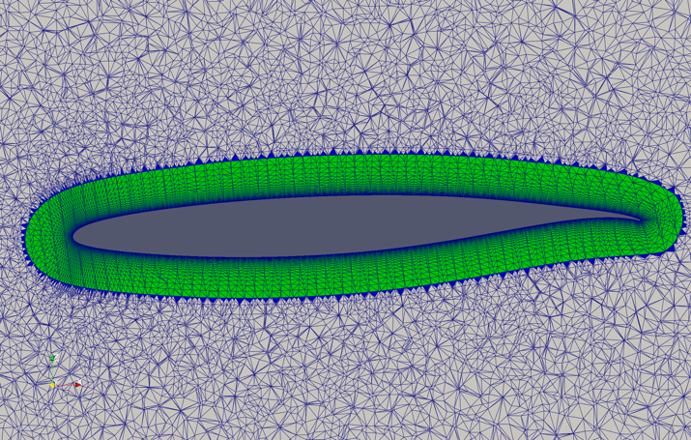
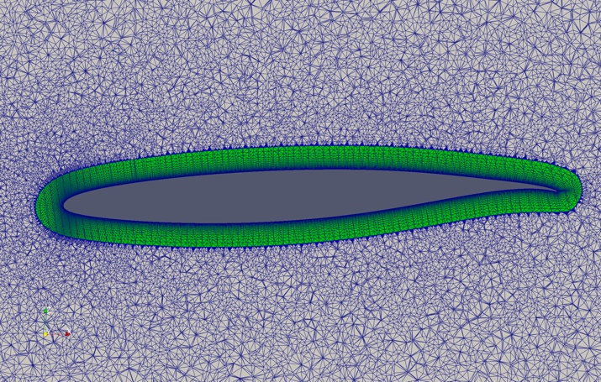
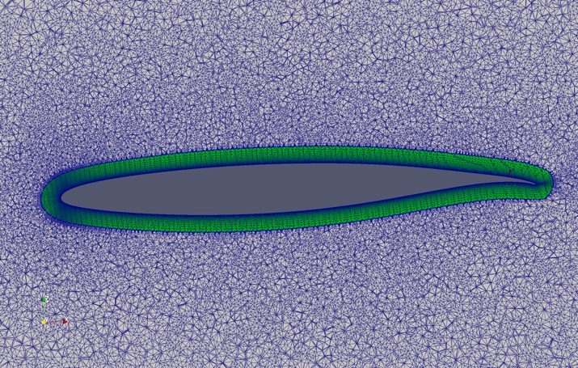
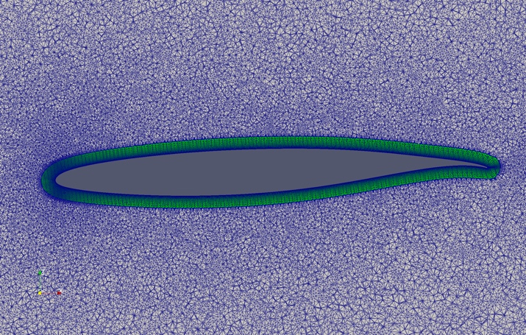
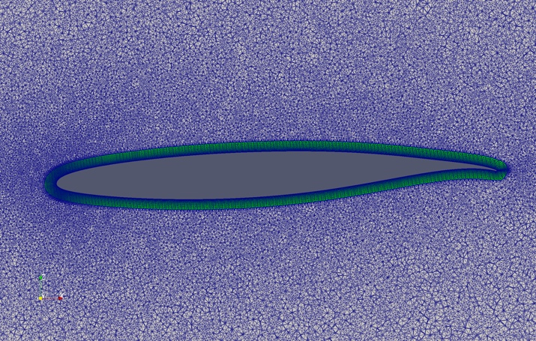
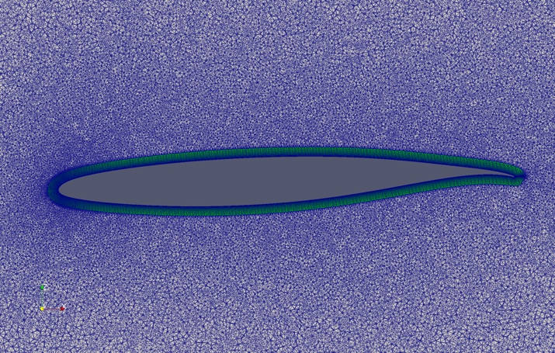
Tiny
Coarse
Medium
Fine
Extra Fine
Ultra Fine
Boundary Layer Height reduced from coarser to finer Meshes
due to automatic Stopping when Cell Aspect Ratio reaches 1

Slide 53
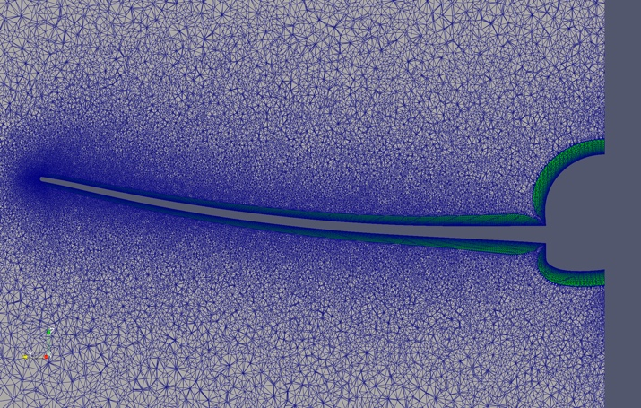
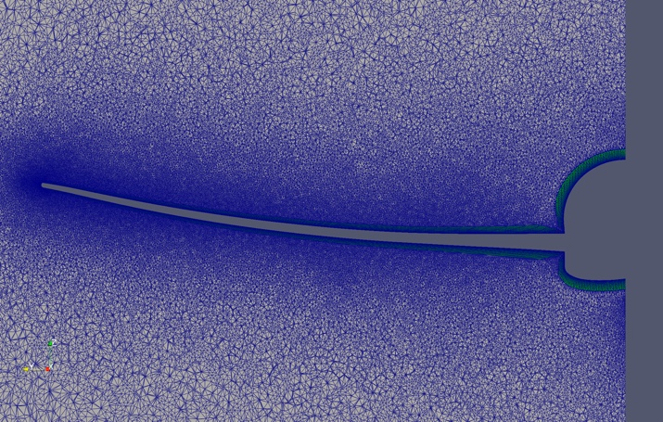
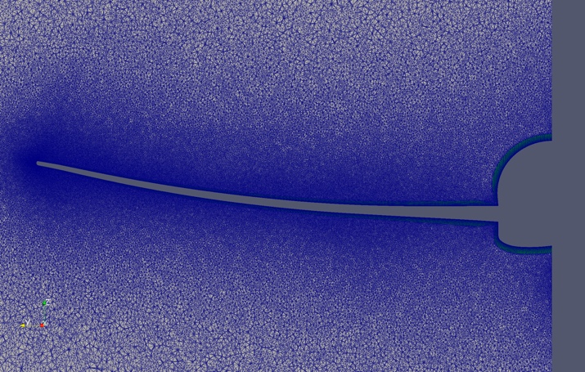
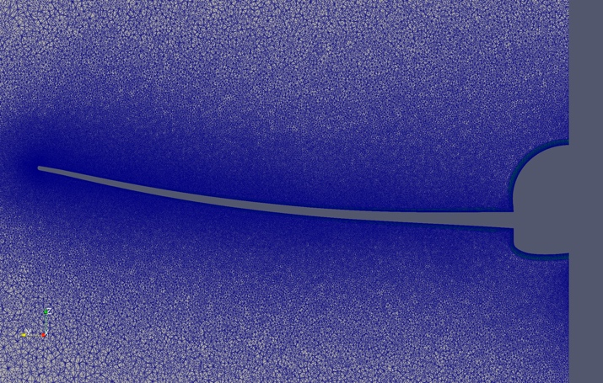
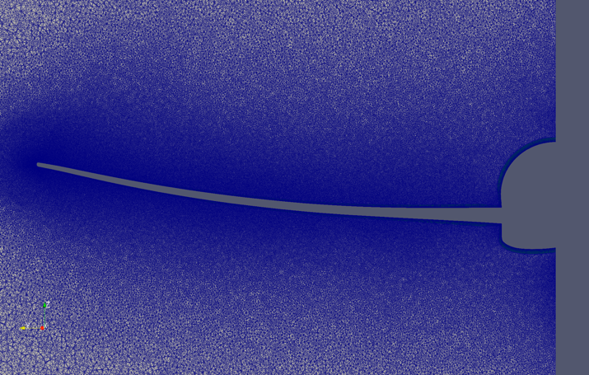
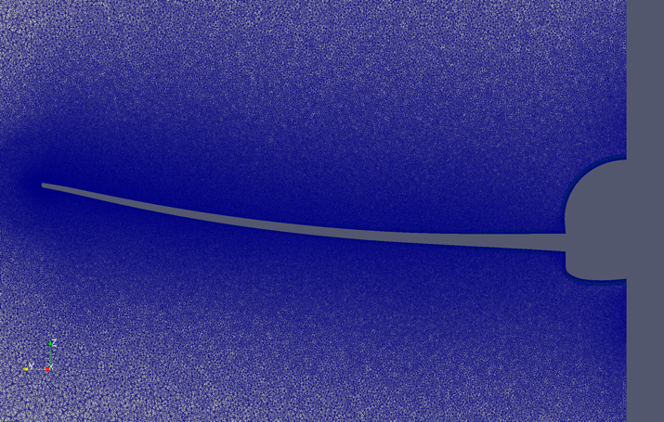
Tiny
Coarse
Medium
Fine
Extra Fine
Ultra Fine

Slide 54
Questions?
DPW-VII Workshop
25-26 June 2022
AIAA Aviation 2022
Applied Aerodynamics Conference
Chicago, IL

Slide 56
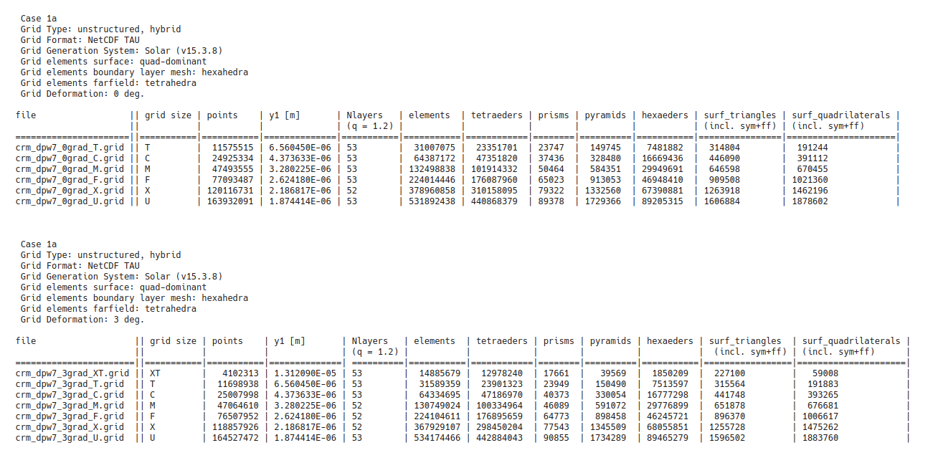
DPW-VII: DLR-SOLAR Grid Family Data
Extra-Tiny ~15M Elements → Ultra-Fine ~530M Elements

Slide 57
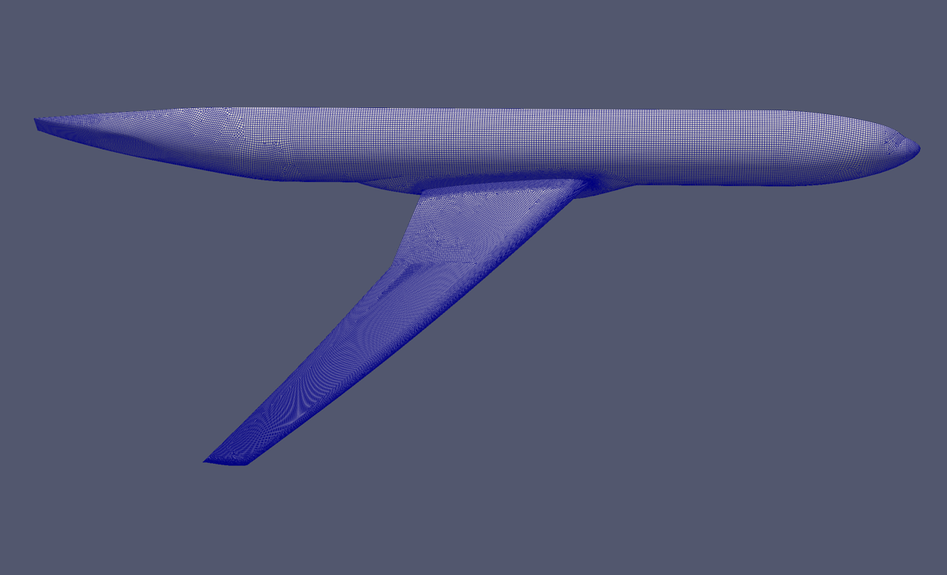
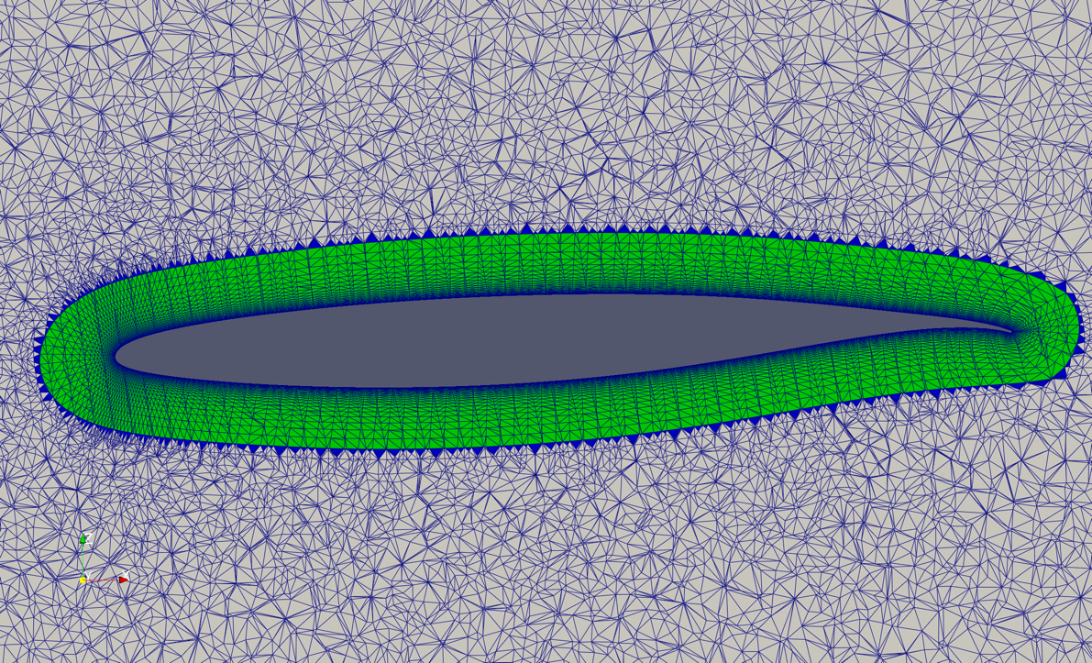
DPW-VII: DLR-SOLAR Grid Topology

Slide 58
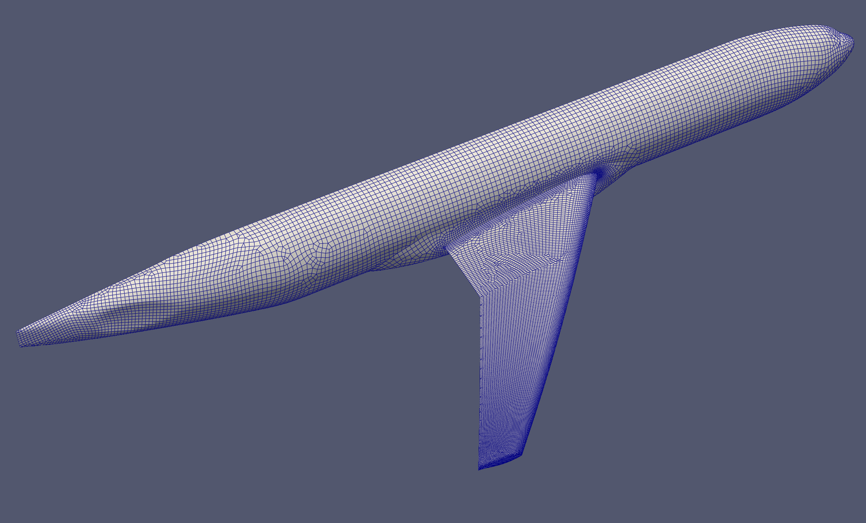
DPW-VII: DLR L0 Extra-Tiny Grid

Slide 59

DPW-VII: DLR L1 Tiny Grid

Slide 60

DPW-VII: DLR L2 Coarse Grid

Slide 61
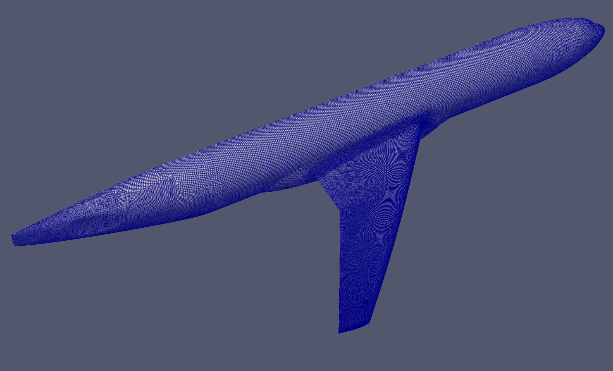
DPW-VII: DLR L3 Medium Grid

Slide 62

DPW-VII: DLR L4 Fine Grid

Slide 63

DPW-VII: DLR L5 Extra-Fine Grid

Slide 64

DPW-VII: DLR L6 Ultra-Fine Grid

